Slide 1

Bank Management System

Slide 2
Submitted To
Md. Mahbubur Rahman
Assistant Professor in Dept. of CSE
Bangladesh University of Business and Technology (BUBT)

Slide 3
Submitted By
Md. Imran Hossain
ID: 15161103032
Department of CSE
Bangladesh University of Business and Technology
Aniruddha Chakraborty
ID: 15161103011
Department of CSE
Bangladesh University of Business and Technology
Taslima Akter
ID: 15161103041
Department of CSE
Bangladesh University of Business and Technology
Md. Intishar Ishmam
ID:15161103037
Department of CSE
Bangladesh University of Business and Technology

Slide 4
Index
Introduction
Objective
Why C# is used?
Log In
Homepage
Account Create
Account Review
Deposit
Withdraw
Transfer Balance
Delete Account
Exit
Our Voice

Slide 5
Introduction
We are now living in the Computer age. Now the computer is controlling all the important works in our routine life. Man has invented many electronic devices but out of these computers has made the greatest impact on society.

Slide 6
Objective
We came to know that it is very difficult for the person to maintain records manually same in the case with the person who is maintaining Books Like Ledgers etc., so in order to provide the bank with such a system that helps them easy in maintaining the records of the customers.

Slide 7
Why C# is used?
C# is a powerful and flexible programming language. Like all programming languages, it can be used to create a variety of applications. ... C# has already been used for projects as diverse as dynamic Web sites, development tools, and even compilers. C# was created as an object-oriented programming (OOP) language

Slide 8
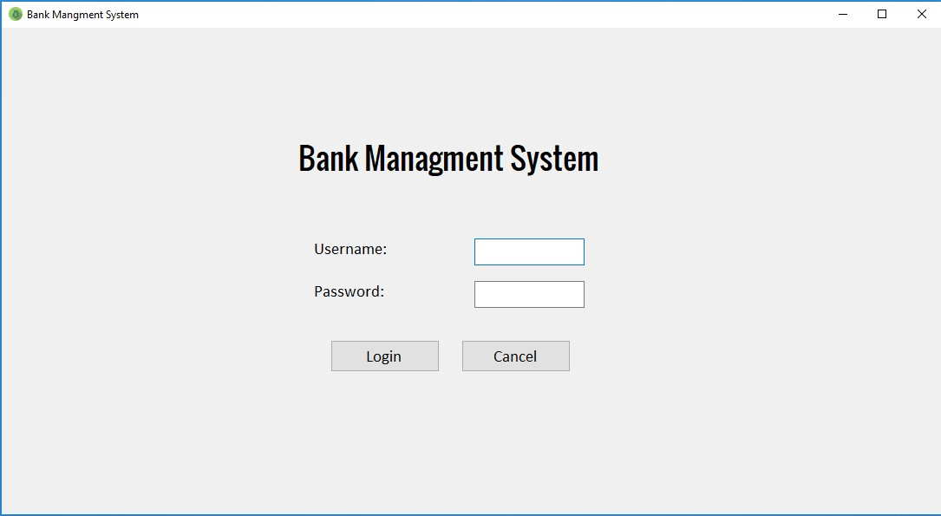
Log In
When we log in to our System, we can see two options one is username and another is password. If the username and password matched appropriately then admin can log in to the system

Slide 9
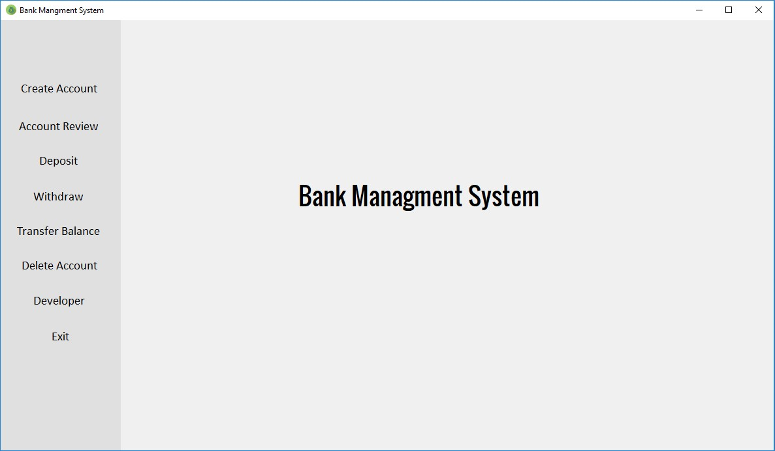
Log In
Homepage
When we are successfully log in to our bank management system, we can see a lot of options.

Slide 10
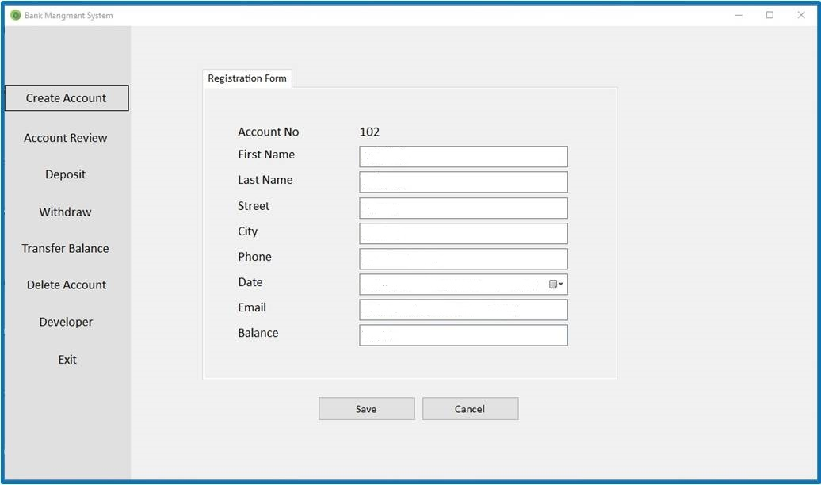
Log In
Homepage
Create Account
In this page the new account number and account registration date will be genarate automatically. At first we input First name, Last name, Street, City, Phone, Email, the Amount and click save button. Then the user information will be saved in out database.
Imran
Hossain
Mirpur
Dhaka
01726959864
05/02/2018
princemahamud@gmail.com
2000

Slide 11
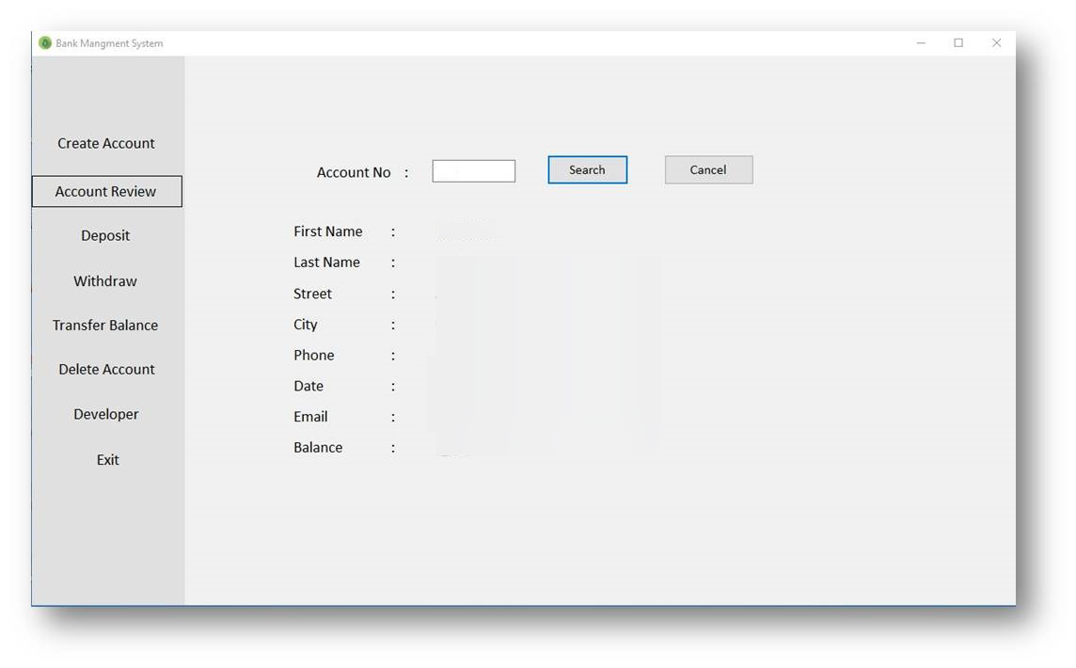
Log In
Homepage
Account Review
Sometimes user want to know details about their account. In this page the admin can search esily any account by their account number and get all details like First name, Last name ,Street, City, Phone, Email, the Amount.
102
Imran
Hossain
Mirpur
Dhaka
01726959864
05/02/2018
princemahamud@gmail.com
2000

Slide 12
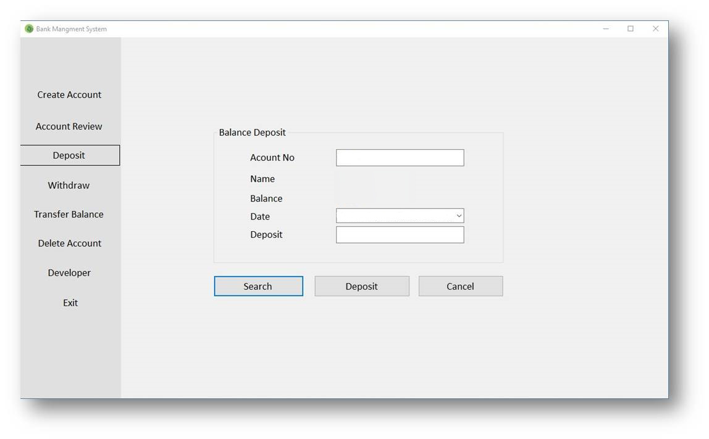
Log In
Homepage
Deposit
When a user want to deposit any amount to his account, he can easily do that by this deposit option. Firstly he will search any account by account number. Then he can see his name and current balance. Now he will input the amount that he want to deposit and press the deposit button.
100
Aniruddha
5488
05/02/2018

Slide 13
Log In
Homepage
Withdraw
When a user want to withdraw any amount from his account, he can easily do that by using this withdraw option. He will search any account by account number. Then he can see his name and current balance. Now he will input the amount that he want to withdraw and press the withdraw button.
100
Aniruddha
5488
05/02/2018
5000

Slide 14
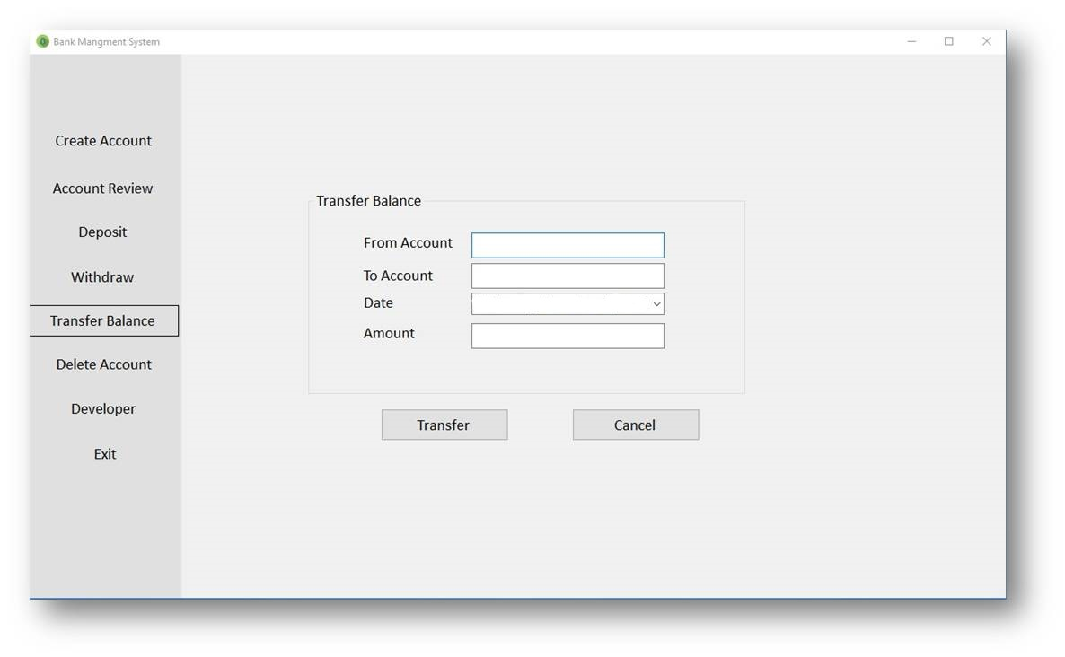
Log In
Homepage
Transfer Balance
Sometimes user want to transfer balance with others account in this bank. Then at first he will submit his account number and another account number where he want to transfer balance. Then he submit the amount that he want to transfer and press the Transfer button. The amount will be transferred sucessfully.
05/02/2018

Slide 15
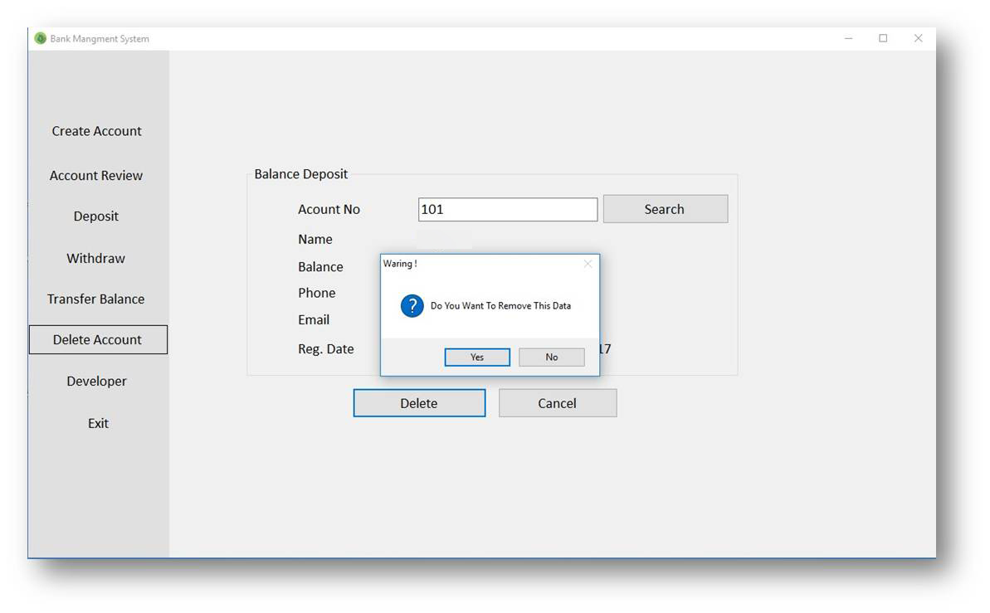
Log In
Homepage
Delete Account
Sometimes user want to delete his account. Then at first he will submit his account number and press the search button. Then he can see his account details. After pressing the delete button, he can see an warning messege ”Do you want to Remove this Data” if he press “Yes” button the account will be removed successfully and if he press “No” button no operation will be execute.
Taslima

Slide 16
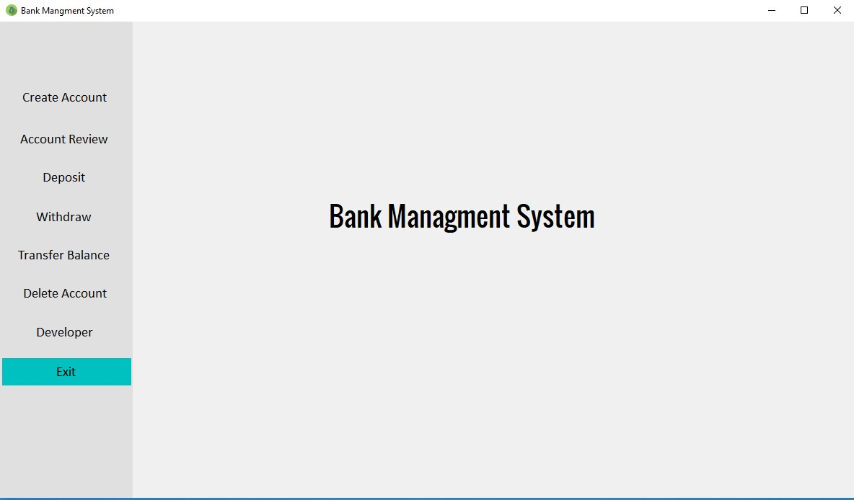
Log In
Homepage
Exit
If we press the Exit button then the system will be closed.

Slide 17
Our Voice
You know our honourable teacher help us to make this “Bank Management System” project. Actually we tried our heart and soul to make this project very efficient and helpful. We add a lot of options in our system. But we are not satisfied . In Sha Allah next time we will do more better project.

Slide 18


